Slide 1
Perceptron
Wonseok Jung

Slide 2


Example of neural network
Perceptron?
Perceptron!
x2
y
x2

Slide 3


Logical circuit
x1
w1
y
w2
x2
0 (w1x1 + w2x2 ≦ theta)
1 (w1x1 + w2x2 > theta )
Y=

Slide 4
Truth Table – AND , NAND
AND
NAND
x1 | x2 | y
0 | 0 | 0
1 | 1 | 1
0 | 1 | 0
1 | 0 | 0
x1 | x2 | y
0 | 0 | 1
1 | 1 | 0
0 | 1 | 1
1 | 0 | 1
Weight and Theta?
Weight and Theta?

Slide 5
Truth Table – OR , NOR
OR
XOR
x1 | x2 | y
0 | 0 | 0
1 | 1 | 1
0 | 1 | 1
1 | 0 | 1
x1 | x2 | y
0 | 0 | 1
1 | 1 | 0
0 | 1 | 0
1 | 0 | 0
Weight and Theta?
???Weight and Theta???

Slide 6
Perceptron with Weight and Bias
0 (w1x1 + w2x2 ≦ theta)
1 (w1x1 + w2x2 > theta )
Y=
Theta
-bias
0 (bias + w1x1 + w2x2 ≦ 0)
1 (bias + w1x1 + w2x2 > 0)
Y=

Slide 7


Weight? Bias?
Weight
x1
w1
y
w2
x2
Bias
b
1
바이어스가 -1 일때 웨이트와 인풋의 곱이 1이 상인 0을 초과해야 1 리턴

Slide 8
Perceptron wi
x1
w1
y
w2
x2
0 (b + w1x1 + w2x2 ≦ 0)
1 (b + w1x1 + w2x2 > 0 )
h(x)
y=h(b+w1x1 +w2x)
0 (x ≦ 0)
h(x)= 1 ( x>0 )
b
1

Slide 9
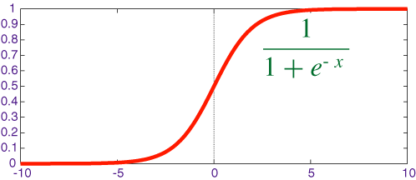
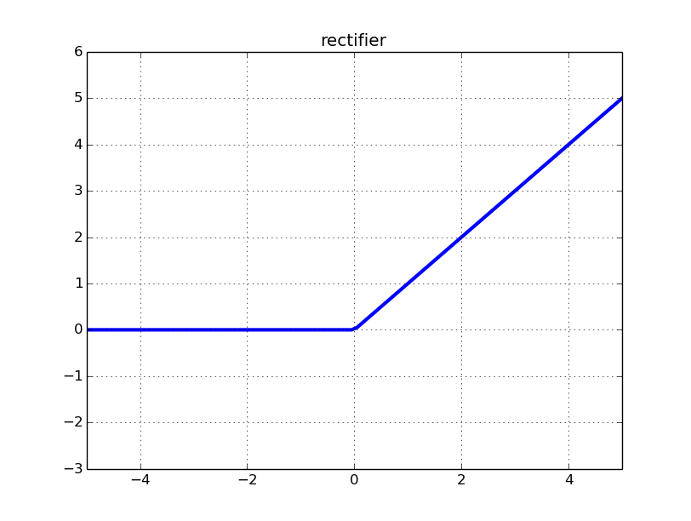
Activation function
H(x) 같이 입력 신호의 총합을 출력 신호로 변환하는 함수를 활성화 함수라고 한다
x1
Sigmoid
x1
w
a
y
w
x2
x2
Relu
b
1
1

Slide 10
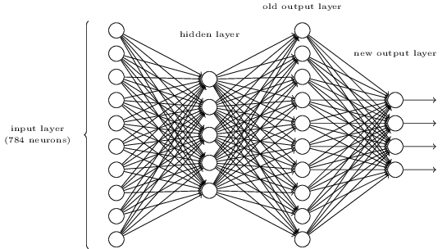

3 layer Neural Network -1
Input layer
Hidden layer
Output layer

Slide 11
3 layer Neural Network -2
1
b
a1= w1x1+ w2x2+ b
a1
w1
x1
A = XW + B
w2
a2
A = ( a1 a2 a3)
X= (x1 x2)
B= (b1 b2 b3)
W= w11 w21 w31
w12 w22 w32
x2
a3
DeepLearning from scratch - Orelly

Slide 12
3 layer Neural Network -3
1
1
a1( WX+b) -> h( ) (activation function) -> z
b
b
h( )
a
z
w1
x1
w2
h( )
a
z
x2
h( )
a
z

Slide 13

3 layer Neural Network -4
1
1
1
a1( WX+b) -> h( ) (activation function) -> z
b
b
h( )
a
z
w1
w1
x1
h( )
a1
a
z
w2
w2
h( )
a
z
x2
h( )
a2
a
z
h( )
a
z

Slide 14
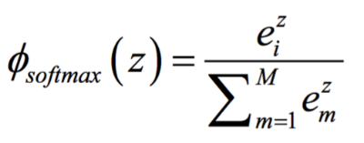
3 layer Neural Network -4
1
σ( ) : Output Layer에는 보통 Softmax Function 을 사용한다.
Output Total value가 1이 되기 때문에 Softmax function 을 사용한 output 을 확률로 계산할 수 있다.
1
1
b
b
h( )
a
z
w1
w1
x1
h( )
σ( )
a
z
a
y
w2
w2
h( )
a
z
x2
h( )
σ( )
a
z
a
y
h( )
a
z

